Slide 1

BillForge KUET Teachers’ Edition
(An automatic bill generator from docx file)
Developed by: Chinmoy Modak Turjo(2k19) & Swaraj Chandra Biswas(2k19)

Slide 2

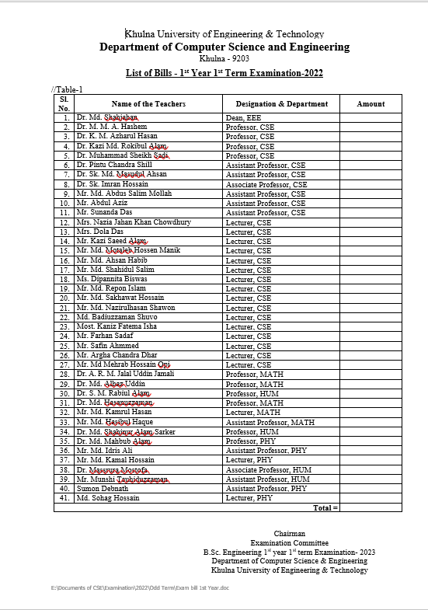
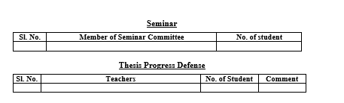
Format of Input Docx:
Input:
1.Input File must be saved in .docx format.
2.Just open your file or document in Microsoft Word and save as .docx format.
Format of Input docx:
1.All Table(15 tables) should be included In input.docx
2.Order of table must be same as example.
3.If no data in any table, just keep a blank table.
Like:
Subjects name must be like->
CSE, EEE, PHY, CHEM, HUM, MATH, ChE, MTE, IEM
and so on

Slide 3
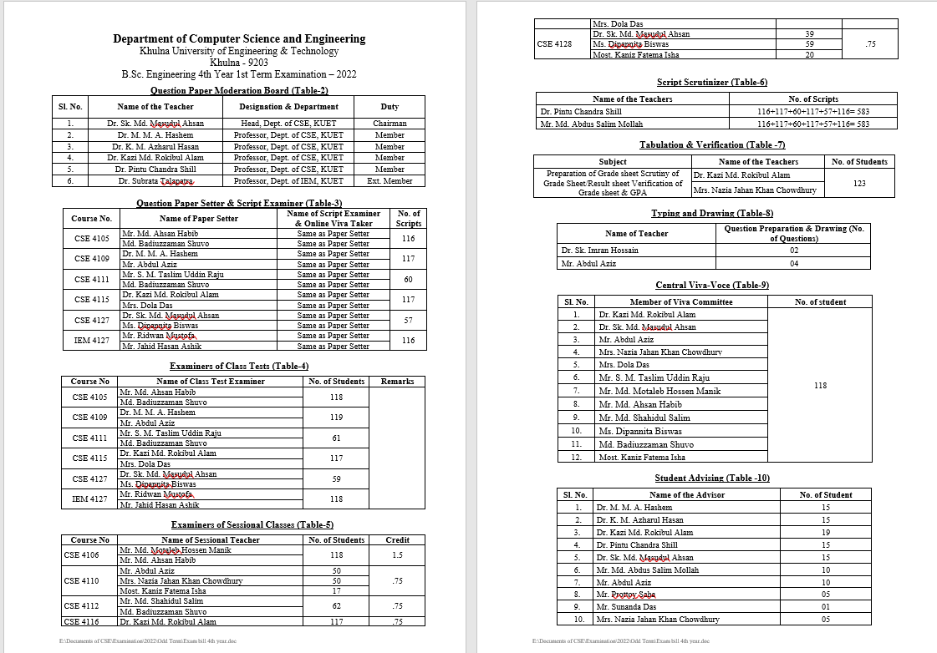
Formate of Input Docx:
If both are same then use
"Same as paper setter“
Or
Insert Teacher’s name

Slide 4
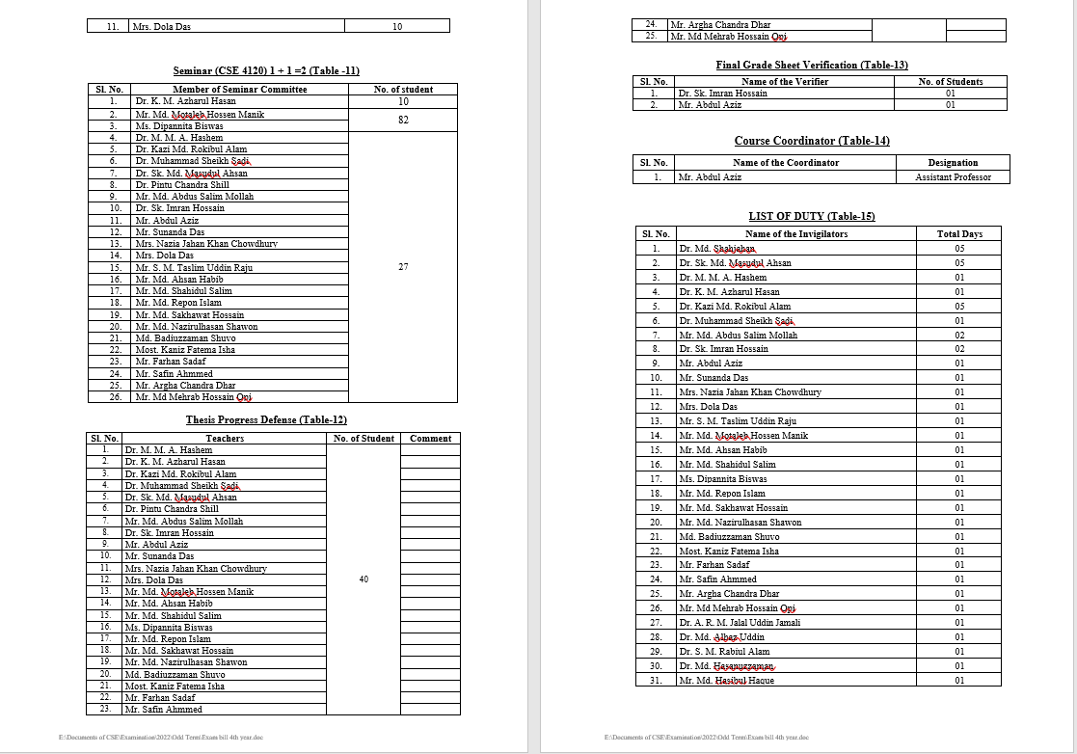
Formate of Input Docx:

Slide 5
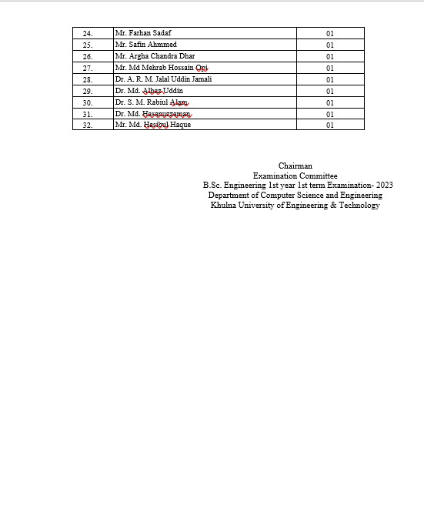
Formate of Input Docx:

Slide 6
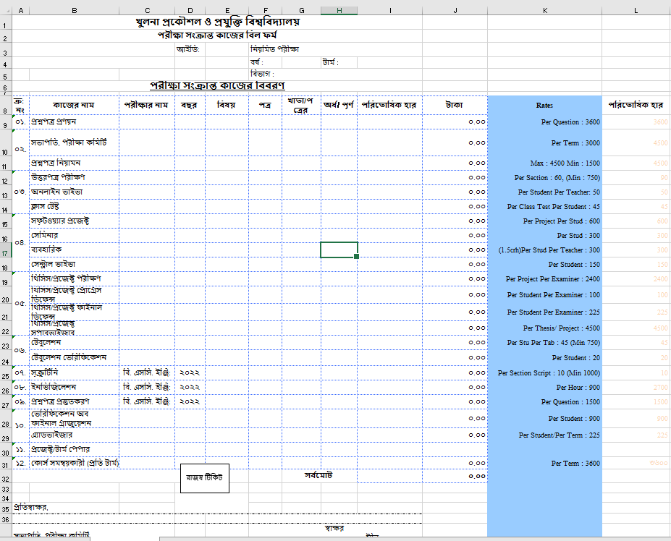
Output excel format:

Slide 7
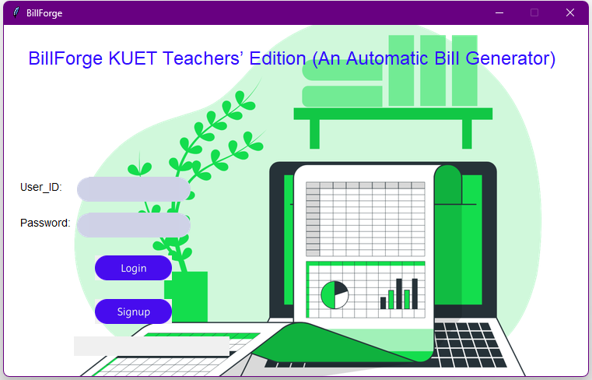
UI:
Firstly , Log in if already have account or Sign Up

Slide 8
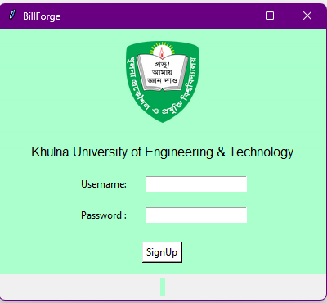
UI Mockup

Slide 9
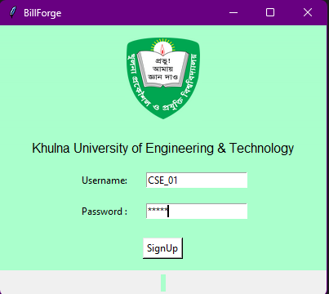
UI Mockup

Slide 10
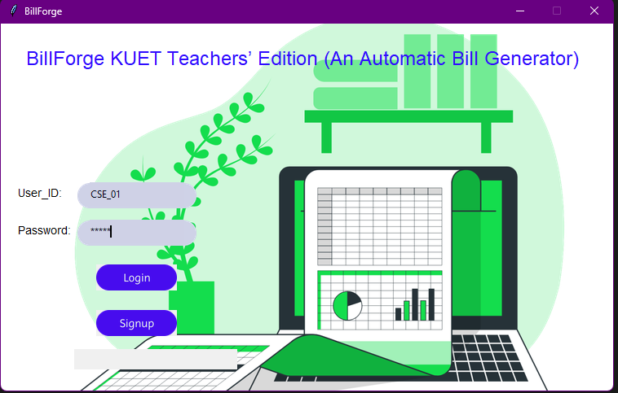
UI Mockup

Slide 11
UI :
NB:After Login, you will find this excel
Check the rates
If needed update rate

Slide 12
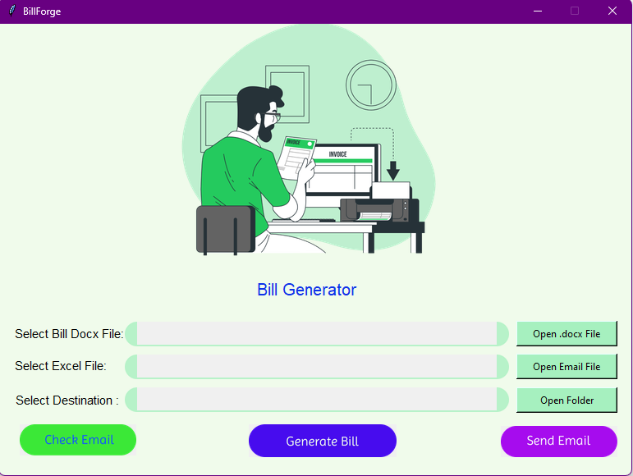
UI Mockup

Slide 13
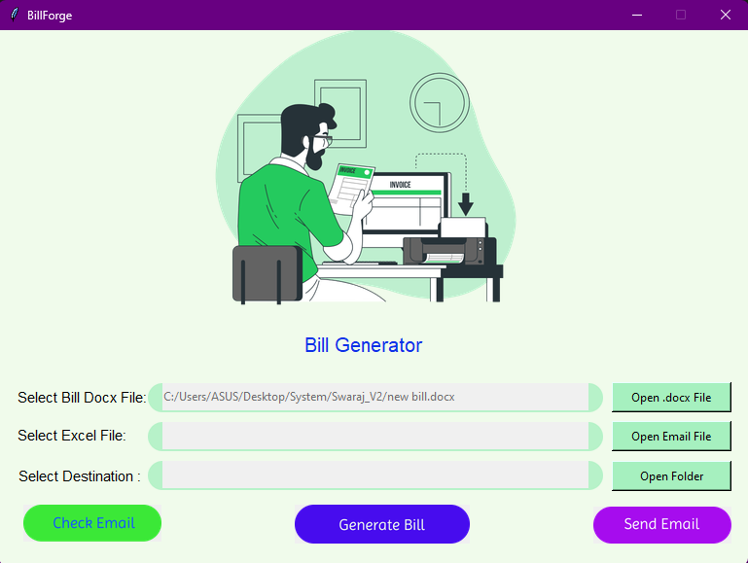
UI Mockup
Doc Picker

Slide 14
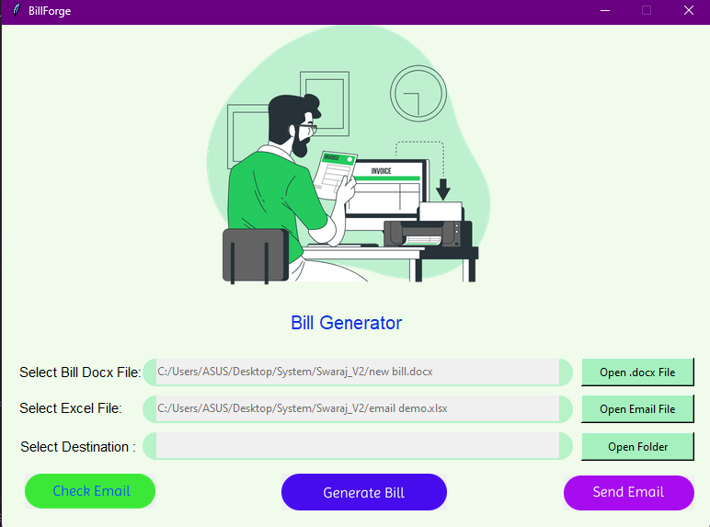
UI Mockup
Email Picker

Slide 15
UI Mockup
Destination Selection

Slide 16
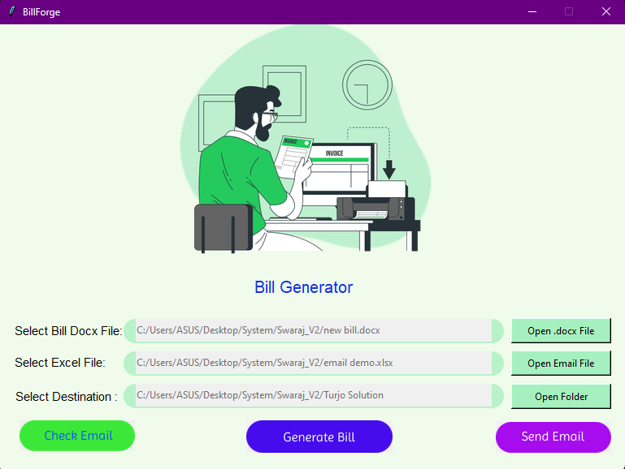
UI Mockup

Slide 17
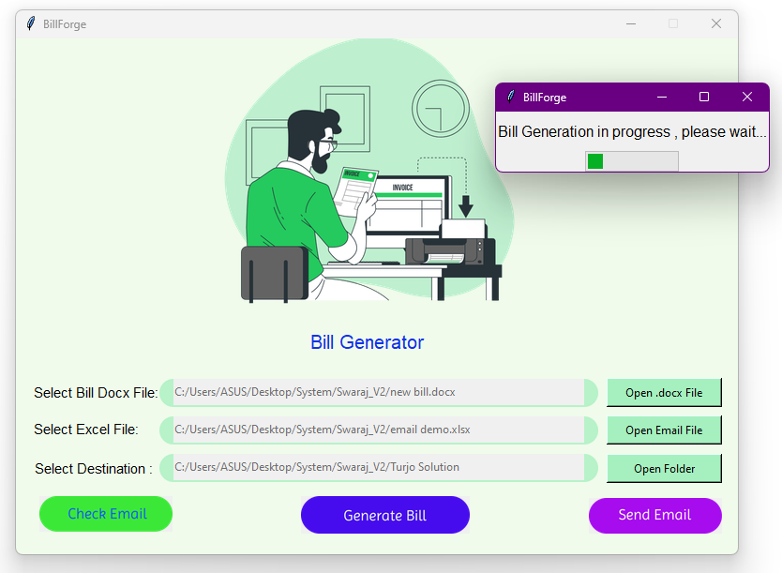
UI Mockup

Slide 18
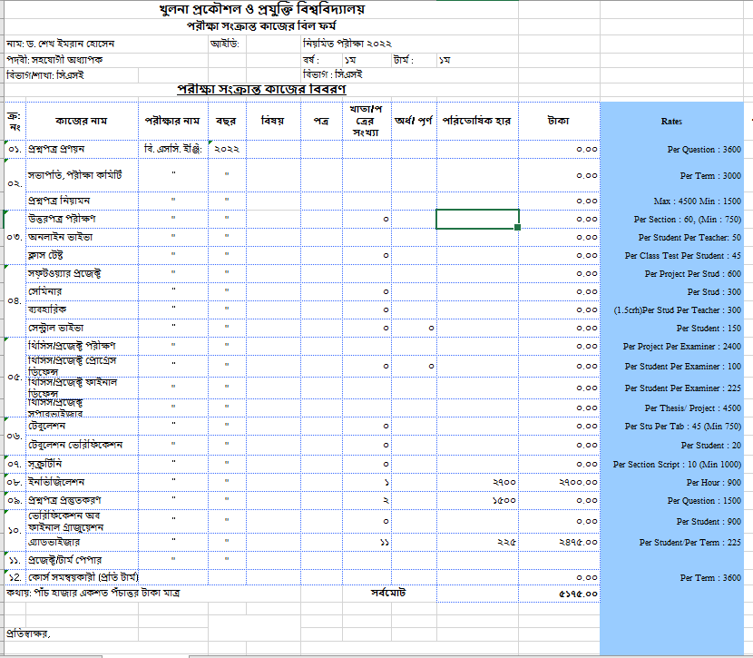
Sample Output of a teacher’s excel:

Slide 19
UI Mockup

Slide 20
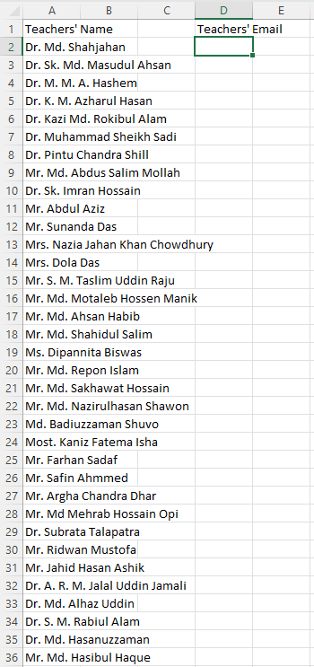
UI Mockup

Slide 21
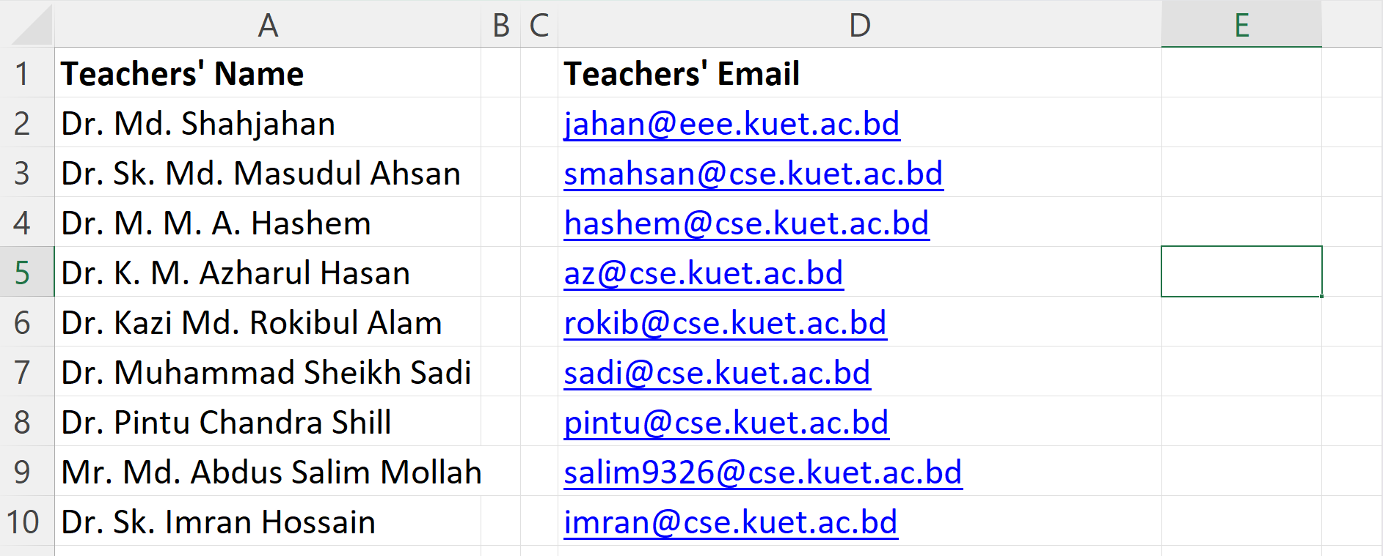
UI Mockup

Slide 22
UI Mockup

Slide 23
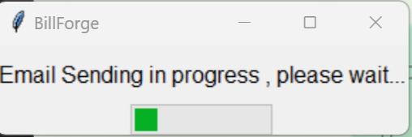
UI Mockup

Slide 24
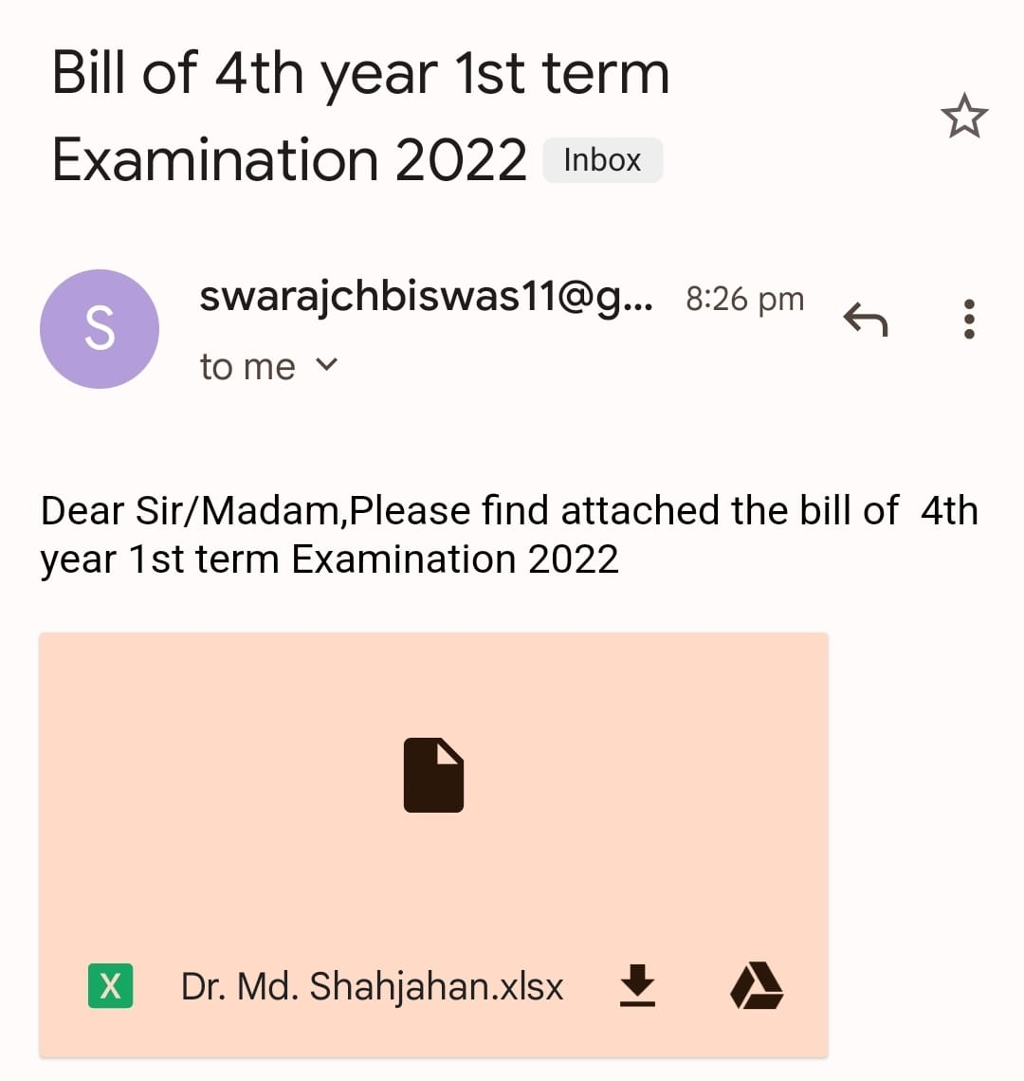
UI Mockup
Email Received

Slide 25
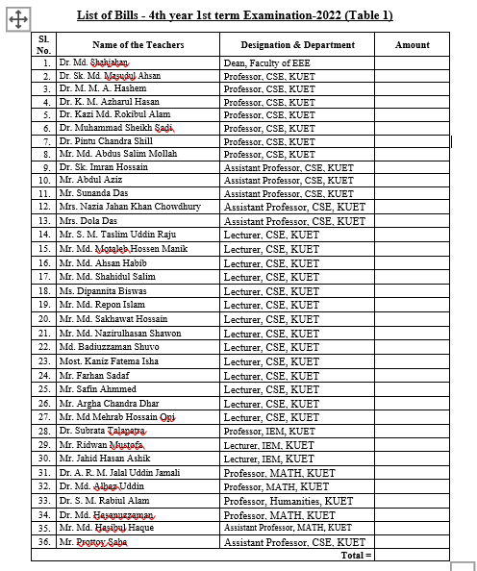
Error Handling:
NB: 1.Table 1 has been considered as reference teacher’s name
2.All teacher’s name must be in this table with correct spelling

Slide 26
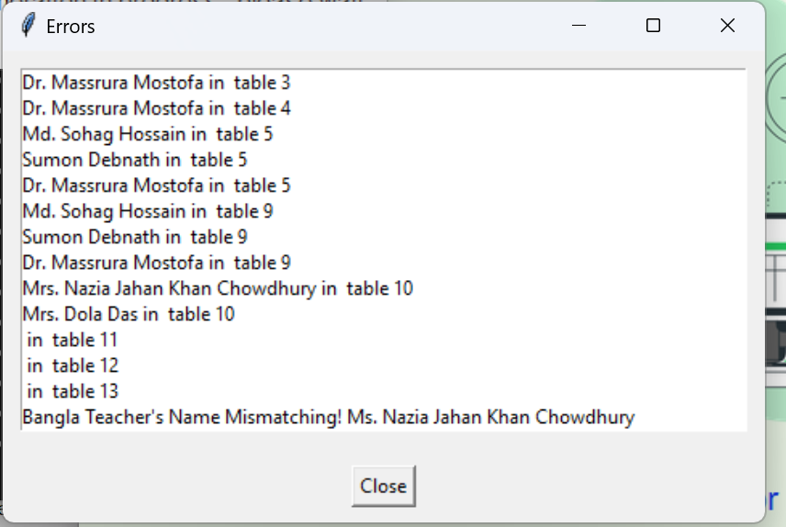

Error Handling:
1.This problem represents name (Dr Massura Mostofa) in table 3,4,5 is not in the first table where all the teachers name are contained. To Solve this issue, Please add the exact name in the first table
2.This (warning)Problem represents missing table entry in table 11,12,13 no need to modify if the table entries are not needed or fill the table entries with appropriate data.
3. This problem says that entry name of Nazia Madam is not in the bangla_name excel file where corresponded bangla teacher’s name are stored. Fill the Teacher name as same in the docx file and fill up relative teacher’s Bengali name.

Slide 27
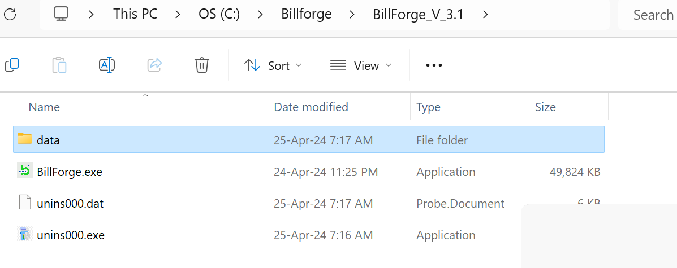
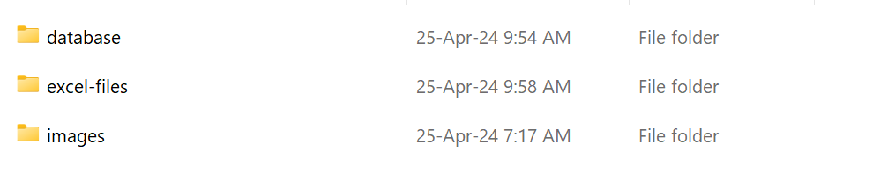
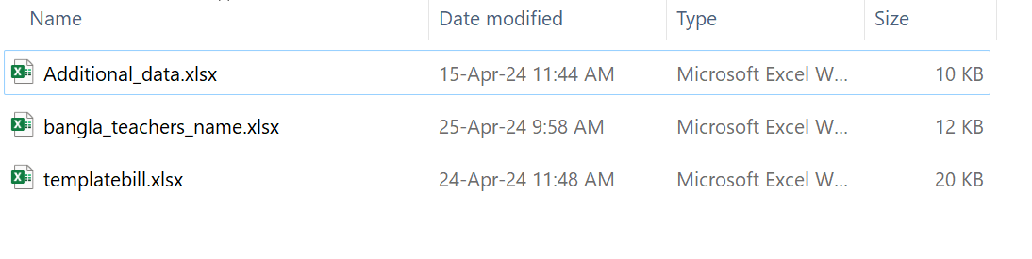
Error Handling: How to Fill Bengali Name of New Teachers
1.First go to the installation directory and go to data folder
2. Now Go to excel-files folder
3.Now Open the bangla_teachers_name.xlsx and modify the file

